Slide 1

Harmonized Model Maintenance Group
Dr. John R. Herring, USA
Mr. Knut Jetlund, Norway
Convenors

Slide 2
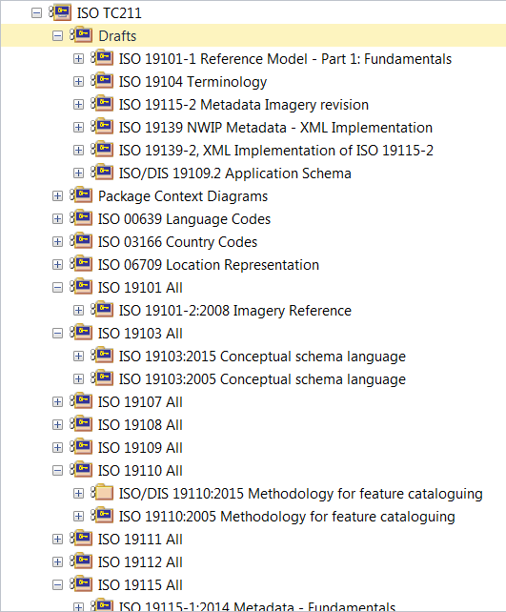
Editing the Harmonized Model
All UML models shall be created in the Harmonized Model
Not imported at a later stage
Contact HMMG Convenors for help
Phase out of Drafts package
HMMG Convenors will create an empty package in the main model and give write privilege to editor
Clean up package names

Slide 3
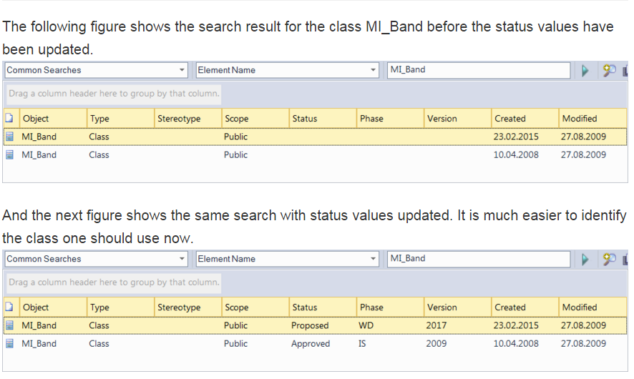
Model metadata: Status, Phase and Version

Slide 4
Quality control of models
Models shall go through a quality control before ballot
Scripts from the best practices work
Scripts for Ontology implementation
HMMG and GOM will help with this

Slide 5
Input from the HMMG Meeting
Need for separate editors for the model and the document (different skills)

Slide 6
ISO/TC211 Ad Hoc Group on best practices for UML modelling
Sydney, Australia 2015-12-09

Slide 7
GitHub https://github.com/ISO-TC211/UML-Best-Practices
https://github.com/ISO-TC211/UML-Best-Practices
For reference documents, scripts, illustrations etc.
https://github.com/ISO-TC211/UML-Best-Practices/wiki
Wiki for UML Best practices
https://github.com/ISO-TC211/UML-Best-Practices/issues
For issue tracking

Slide 8
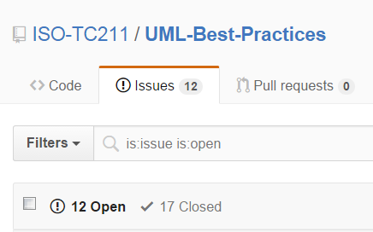
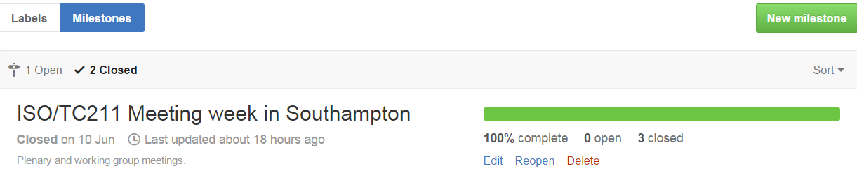

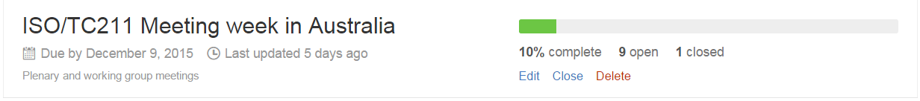
Progress report

Slide 9
Status
Much work done on diagram design
Few issues open
Much work done on modelling
Several issues open
Much work done on documentation
Much work done on scripts and tools
Scripts in VBScript, JScript, searches (XML)
Several contributors have scripts that have been uploaded
Much work done on basic UML
Relevant requirements and recomendations
Levels of abstraction
Few issues open
Much left to do on implementation issues
Few issues open

Slide 10

New UML BP issues
Scripts
Naming conventions for scripts.
More sample scripts (GOM and others)
Group of scripts for model validation
Sample scripts in models
Scripts for definition import/export
References to the XML and GOM Wikis
Composition vs association
Geometry constraints
Voidable
Model metadata
Package structure
Illustrating changes between versions

Slide 11

Revised action plan
Continue AHG up to next meeting
Alternatives for further work - to be decided at next meeting:
Continue as AHG
Merge into HMMG
Create new permanent group, associated to HMMG
No matter what happens:
Continue the work
Wiki to be moved to official ISO/TC211 Wiki in the future

